Slide 1

Which news is fake?
Project 3
Metis Data Science Bootcamp
By Ouyang Yingzhao
Photo by Max Muselmann on Unsplash

Slide 2
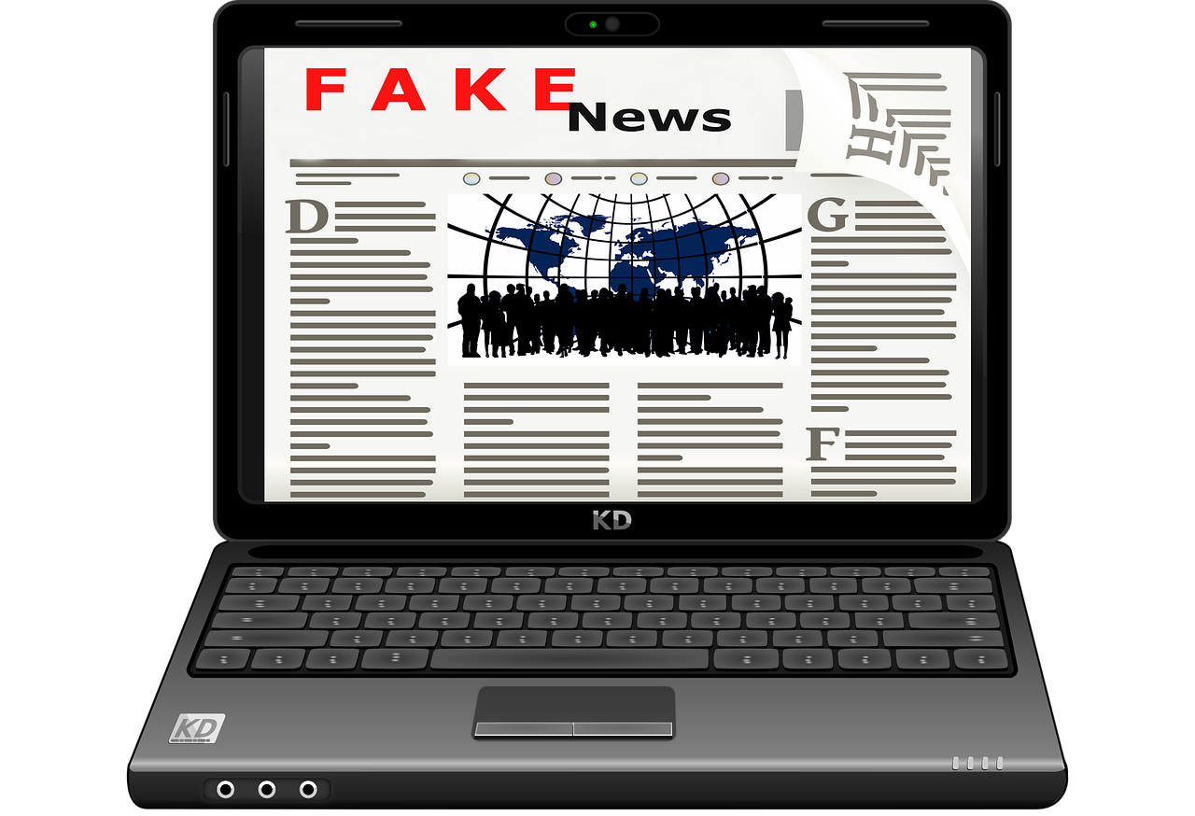
Why should we care?
In the US:
Over half claim to regularly see fake news on sites such as Facebook or Twitter.
Over a quarter rarely trusted the news that they read on social media
14 percent said that they have deliberately shared a fake political news story online
Source: Fake News - Statistics & Facts by Amy Watson on Staista, May 5 2020
Image by S. Hermann & F. Richter from Pixabay

Slide 3
Objectives
Based on features derived from the LIAR dataset (2017)...
…predict which piece of news is fake

